Slide 1
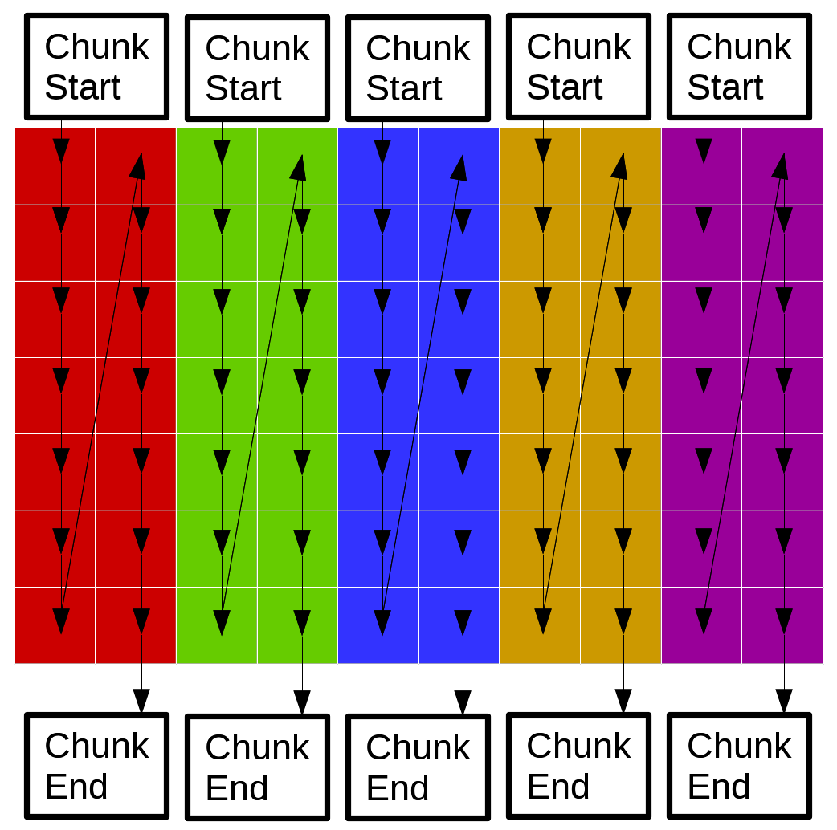
Parallel Implementation
- Instead of one thread doing the kernel for a single pixel at a time, we have several.
- Let each thread handle one vertical “chunk” of the image.
- All threads use the same object for reading pixels and the same object for writing pixels.

Slide 2
Contention
Chunks are width (matrix size)x2 --> threads work on pixels far away from each other.
Unlikely that the same pixel will be accessed by two threads at the same time. But they will access pixels on the same cache line (row)...
...but effects of contention are minimal:
Tests on doing processing row wise or column wise reveal negligible difference. Thus contention due to the cache line is negligible.
Explanation: The image data structure stores pointers – contention on fetching pointers (size int) is a tiny part of actually modifying the pixel value the pointer points to. And once the pointer is fetched, contention will not arise for the rest of that pixel’s processing.
Thus it’s better not to split the source and output image into separate objects before doing the kernel (waste of time).

